Slide 1

Introduction to Recurrent Neural Networks
Vanilla RNN / Long-Short Term Memory / Gated Recurrent Unit
Dr. Risman Adnan Mattororang
Telkom University

Slide 2
Outline
Why not feed-forward neural networks
What is recurrent neural networks
Issue with recurrent neural networks
Vanishing and exploding gradient
Introduction to long-short term memory
Gated Recurrent Unit

Slide 3
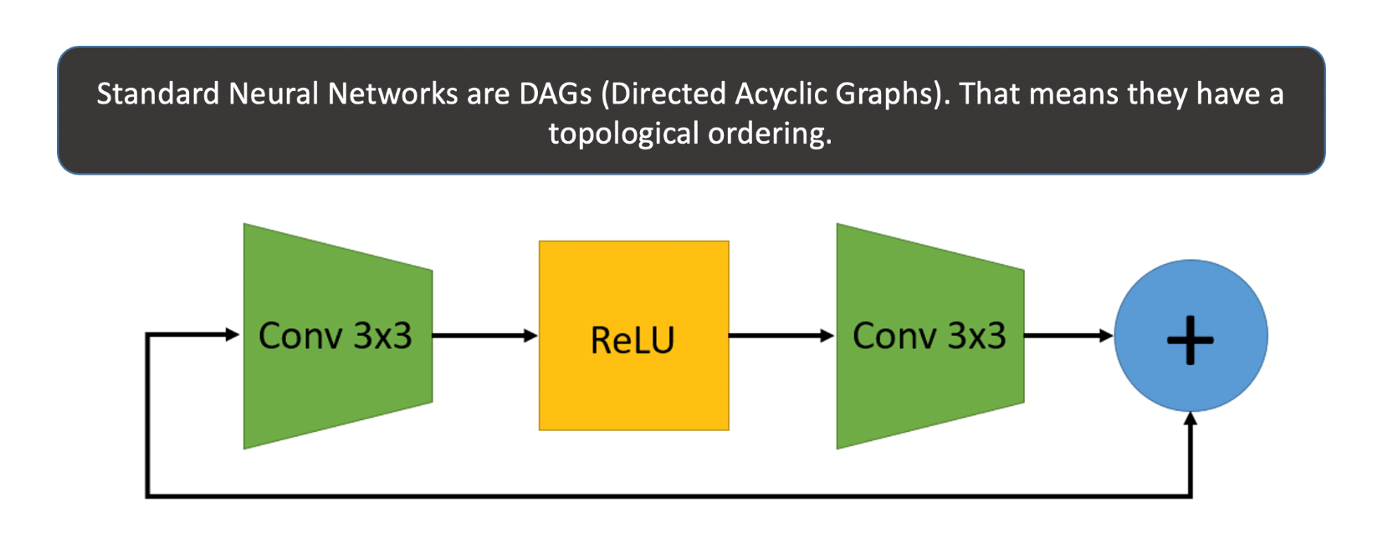
Feed-forward Structure
“They process one input instance at a time.”

Slide 4

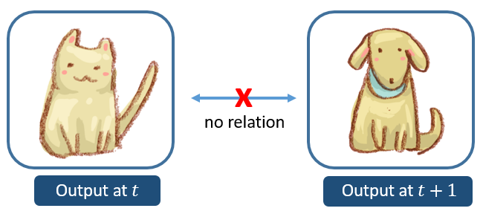
Why not feed-forward neural networks
Notes:
Seeing image a cat will not perceive network to output dog in the next

Slide 5
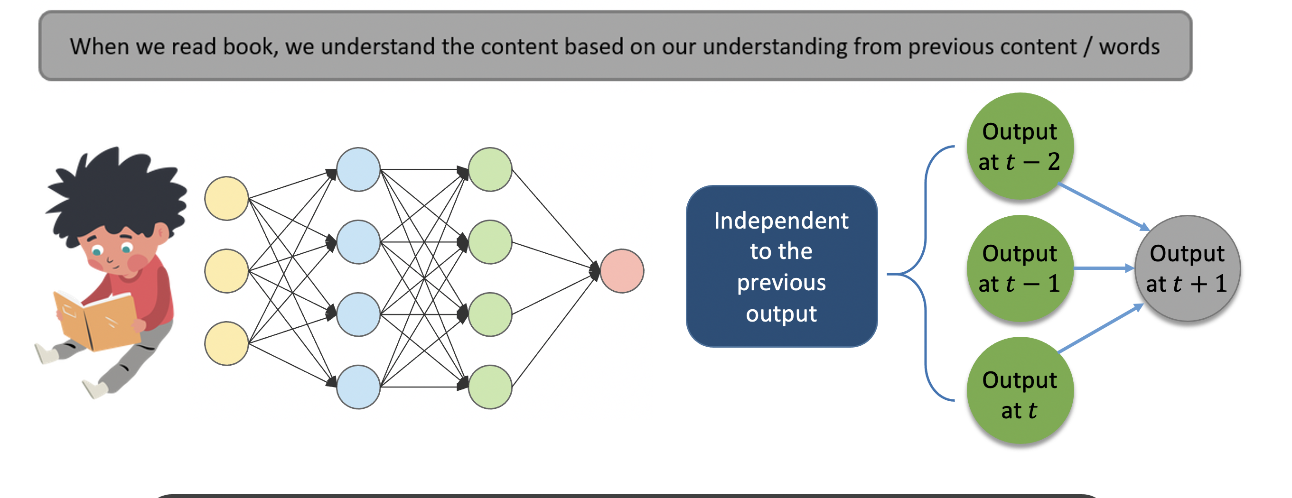
Why not feed-forward neural networks

Slide 6
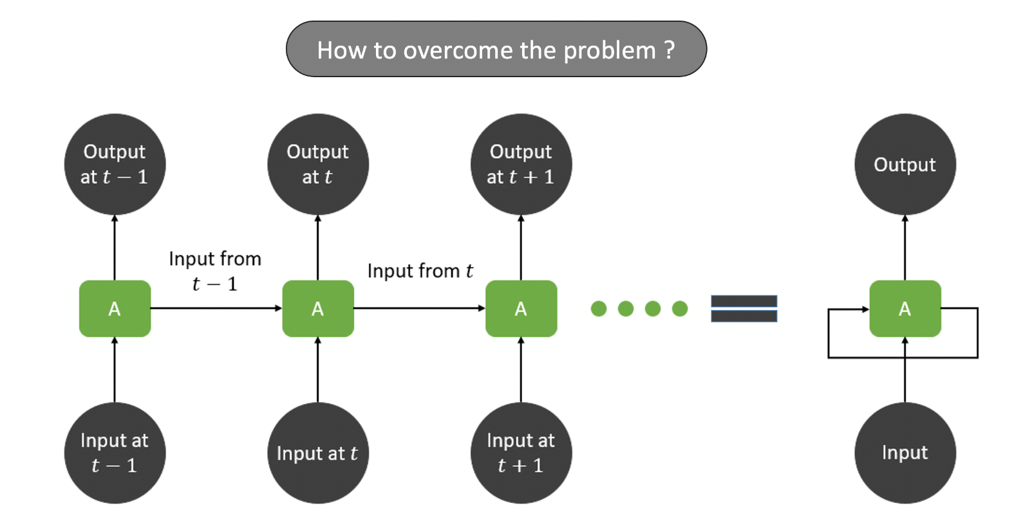
Why not feed-forward neural networks

Slide 7
Outline
Why not feed-forward neural networks
What is recurrent neural networks
Issue with recurrent neural networks
Vanishing and exploding gradient
Introduction to long-short term memory
Gated Recurrent Unit

Slide 8
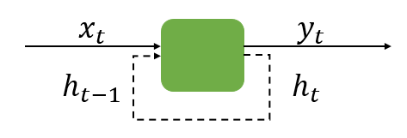
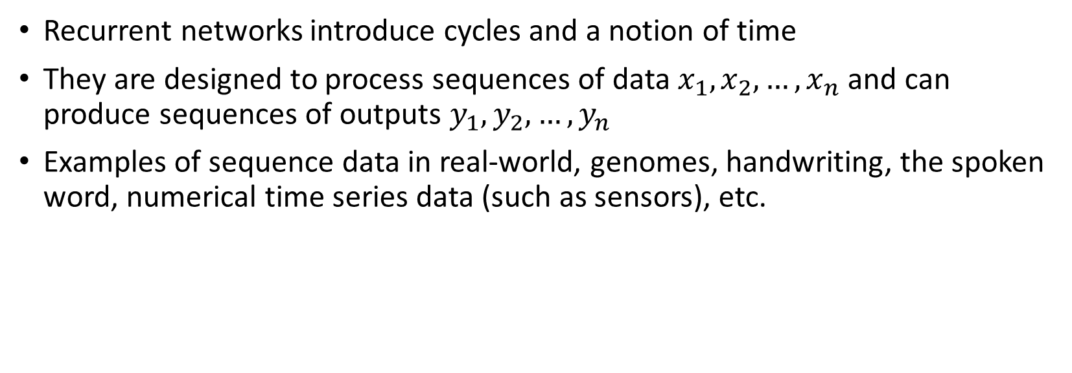
What is recurrent neural networks ?
Recurrent networks introduce cycles and a notion of time
They are designed to process sequences of data $x_{1}, x_{2},…, x_{n}$ and can produce sequences of outputs $y_{1}, y_{2}, …, y_{n}$
Examples of sequence data in real-world, genomes, handwriting, the spoken word, numerical time series data (such as sensors), etc.

Slide 9

What is Recurrent Neural Network
“An analogy and real-world use case”

Slide 10
What is recurrent neural networks ?
Predicted shoulder exercise yesterday
Shoulder exercise
Shoulder exercise
Predicted biceps exercise yesterday
Shoulder exercise
Biceps exercise
Biceps exercise
Predicted cardio exercise yesterday
Biceps exercise
Cardio exercise
Cardio exercise
Shoulder exercise yesterday
Cardio exercise
Biceps exercise yesterday
Predicting type of exercise
Cardio exercise yesterday

Slide 11
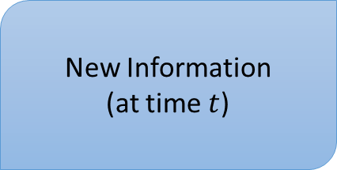
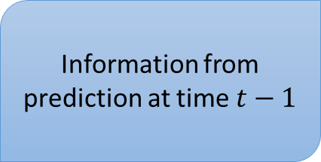
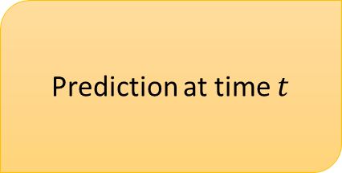
What is recurrent neural networks ?
Information from prediction at time $t−1$
Prediction at time $t$
New Information
(at time $t$)
Predicting type of exercise

Slide 12
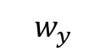
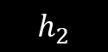
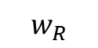
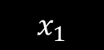
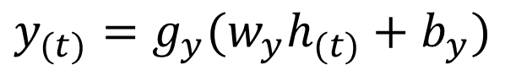
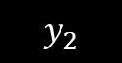
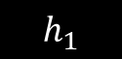
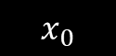
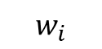
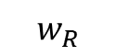
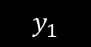
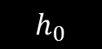
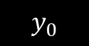
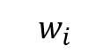
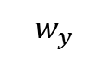
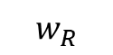
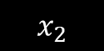
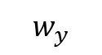
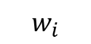
What is recurrent neural networks ?
$$y_{0}$$
$$y_{1}$$
$$y_{2}$$
$$w_{y}$$
$$w_{y}$$
$$w_{y}$$
$$h_{(t)}=g_{h}(w_{i}x_{t}+w_{R}h_{\left(t−1\right)}+b_{h})$$
$$w_{R}$$
$$w_{R}$$
$$w_{R}$$
$$h_{0}$$
$$h_{1}$$
$$h_{2}$$
$$y_{(t)}=g_{y}(w_{y}h_{(t)}+b_{y})$$
$$w_{i}$$
$$w_{i}$$
$$w_{i}$$
$$x_{0}$$
$$x_{1}$$
$$x_{2}$$

Slide 13
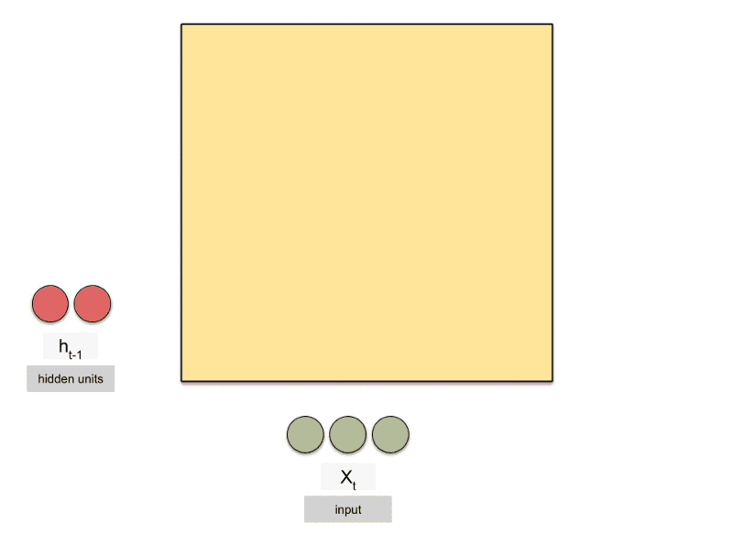
Animated RNN

Slide 14
(Recall) Feedforward NN Vs Recurrent NN
Output
Output
Input
Hidden
Hidden
Input +
Previous hidden

Slide 15

Recurrent Neural Networks
Why ?
$$[input+previous hidden]→Hidden→Output$$
And why not
$$[input+previous input]→Hidden→Output$$

Slide 16
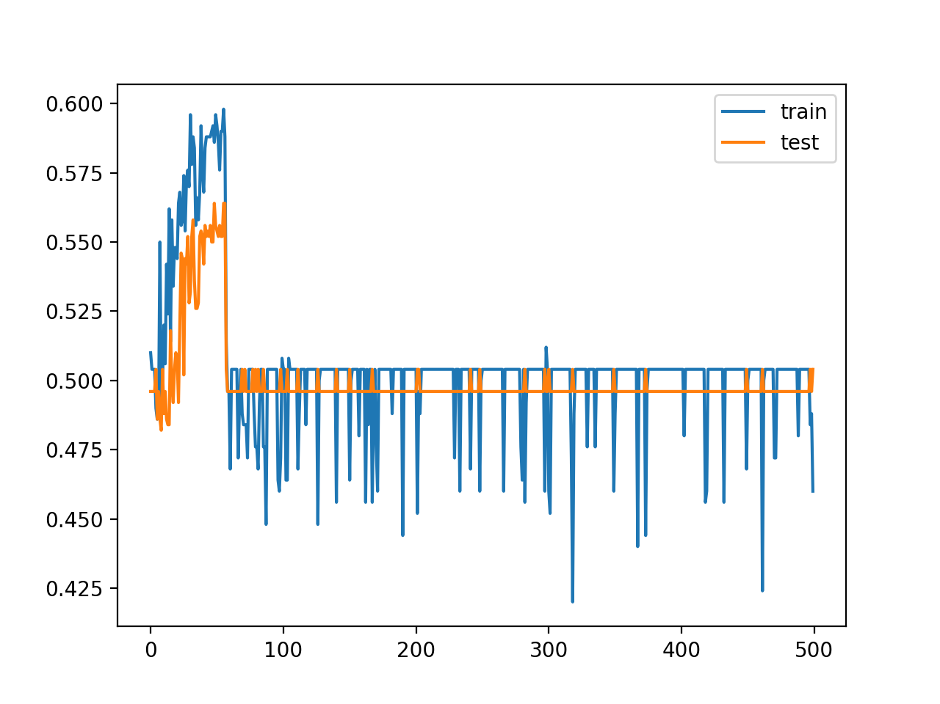

Training a recurrent neural networks
Recurrent neural networks uses backpropagation algorithm, however this algorithm applied for every timestamp. It is known as backpropagation through time (BTT)
Vanishing gradient problem
Exploding gradient problem

Slide 17
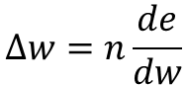
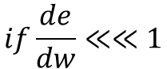
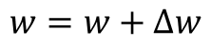
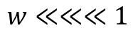
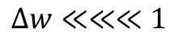
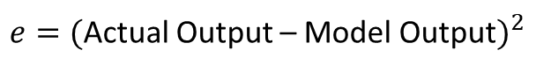
Problem with RNN
Backpropagation
Vanishing gradient problem
$$w=w+∆w$$
$$∆w=n\frac{de}{dw}$$
$e=($Actual Output – Model Output$)^{2}$
$$if\frac{de}{dw}≪≪1$$
$$Δw≪≪≪1$$
$$w≪≪≪1$$

Slide 18
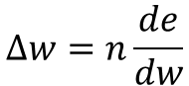
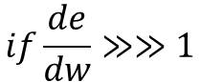
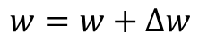
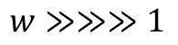
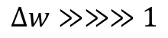
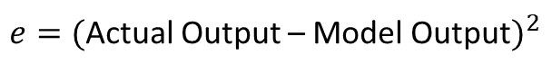
Problem with RNN
Exploding gradient problem
Backpropagation
$$w=w+∆w$$
$$∆w=n\frac{de}{dw}$$
$e=($Actual Output – Model Output$)^{2}$
$$if\frac{de}{dw}≫≫1$$
$$Δw≫≫≫1$$
$$w≫≫≫1$$

Slide 19
How to overcome RNN Challenges ?
Vanishing Gradient Problem
Exploding Gradient Problem
ReLU activation function we can use activation like ReLU, which gives us output 1 while calculating gradient
Clipping Clip the gradient value when it goes lower than threshold
LSTM / GRUs Different network architecture that has been designed to overcome this problem
Truncated BTT Instead of we start backpropagation at the last timestamp, we choose smaller timestamp such as 10 (we will lose temporal context after 10 timestamp)
Clipping Clip the gradient value when it goes bigger than threshold
RSMProp Using RMSProp to adjust learning rate
Notes:
What is time step?

Slide 20
Outline
Why not feed-forward neural networks
What is recurrent neural networks
Issue with recurrent neural networks
Vanishing and exploding gradient
Introduction to long-short term memory
Gated Recurrent Unit

Slide 21
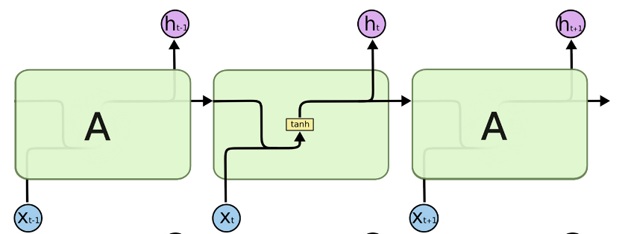
Long Short Term Memory Networks
Long short term memory – usually called LSTM, are special kind of RNN
Capable of long-term dependencies
A repeating module in standard RNN

Slide 22
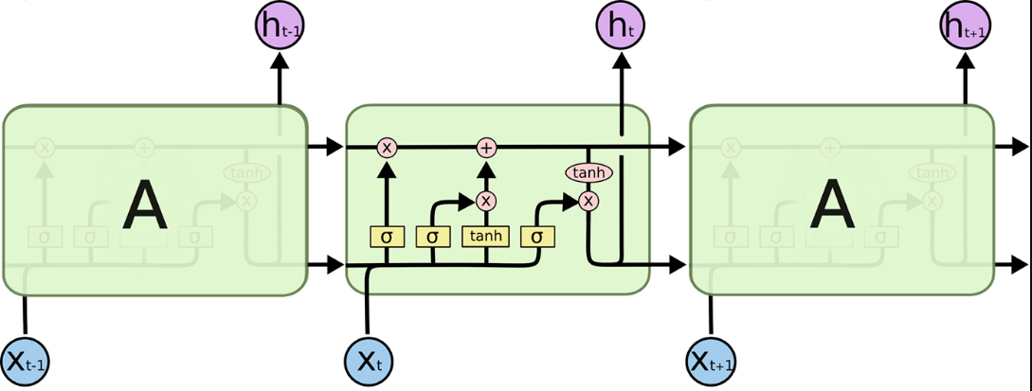
Long Short Term Memory Networks

Slide 23

Long Short Term Memory Networks
Cell state is the key of LSTM
It runs straight down the entire chain, with only some minor linear interactions
Information can be added or deleted from this state vector via the forget and input gates.

Slide 24

LSTM Cell State
Illustration
Want to remember person & phone number
Forget gate will remove existing information of a prior subject when a new one is encountered.
Input gate "adds" in the information for the new subject.

Slide 25

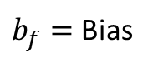
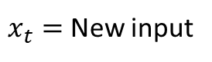
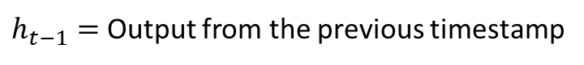
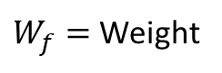
Long Short Term Memory Networks
Step – 1
Identify the information that and it will be thrown from the cell state. This decision is made by sigmoid layer called as forget gate layer
$W_{f}=$ Weight
$h_{t−1}=$ Output from the previous timestamp
$x_{t}=$ New input
$b_{f}=$ Bias
Notes:
Adding sigmoid gate

Slide 26

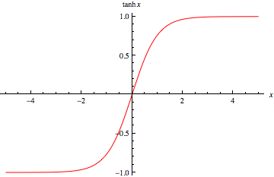
Long Short Term Memory Networks
Step – 2
Decide what is new information we are going to store in cell state. This whole process comprises of the following steps. A sigmoid layer called the input gate layer, decide which values will be updated. Next a tanh layer create a vector of a new candidate values, that could be added to the state

Slide 27

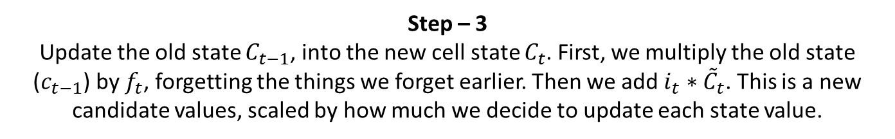
Long Short Term Memory Networks
Step – 3
Update the old state $C_{t−1}$, into the new cell state $C_{t}$. First, we multiply the old state ($c_{t−1}$) by $f_{t}$, forgetting the things we forget earlier. Then we add $i_{t}∗{\tilde{C}}_{t}$. This is a new candidate values, scaled by how much we decide to update each state value.

Slide 28

Long Short Term Memory Networks
Step – 4
Run sigmoid layer which decide what part of the cell state we are going to output. Then we put the cell state through tanh (push value between -1 and 1) and then multiply it by the output of the sigmoid gate, so that we only output the part we decide.
Notes:
Adding tanh gate

Slide 29

Animated LSTM

Slide 30

Summary of LSTM Application Arch.
Image Captioning
Video Activity Recognize
Text Classification
Video Captioning
Machine Translation
POS Tagging
Language Modeling

Slide 31
Outline
Why not feed-forward neural networks
What is recurrent neural networks
Issue with recurrent neural networks
Vanishing and exploding gradient
Introduction to long-short term memory
Gated Recurrent Unit

Slide 32

Gated Recurrent Unit (GRU)
A very simplified version of the LSTM
Merge forget & input gate into single “update” gate
Merge cell and hidden state
Has fewer parameters than LSTM & has been shown to outperform LSTM on some tasks.
Learning Phrase Representations using RNN Encoder-Decoder for Statistical Machine Translation, Cho et al., 2014

Slide 33

GRU vs LSTM
GRU has significantly fewer parameters and trains faster.
Experimental results comparing the two are still inconclusive, many problems they perform the same, some better than the other on some tasks.

Slide 34

Animated GRU

Slide 35


Attention Layer (Advanced Topic)
For many applications, it helps to add “attention” to RNNs.
The Attention mechanism in Deep Learning is based off this concept of directing your focus, and it pays greater attention to certain factors when processing the data
Allows network to learn to attend to different parts of the input at different time steps, shifting its attention to focus on different aspects during its processing.

Slide 36
Thank You

